Slide 1
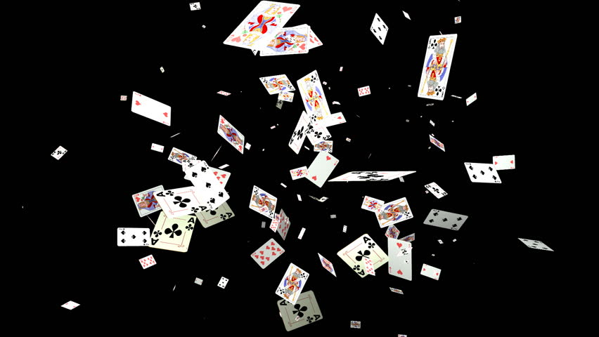
Visual Guide
Guide to CaViTi’s Karma

Slide 2
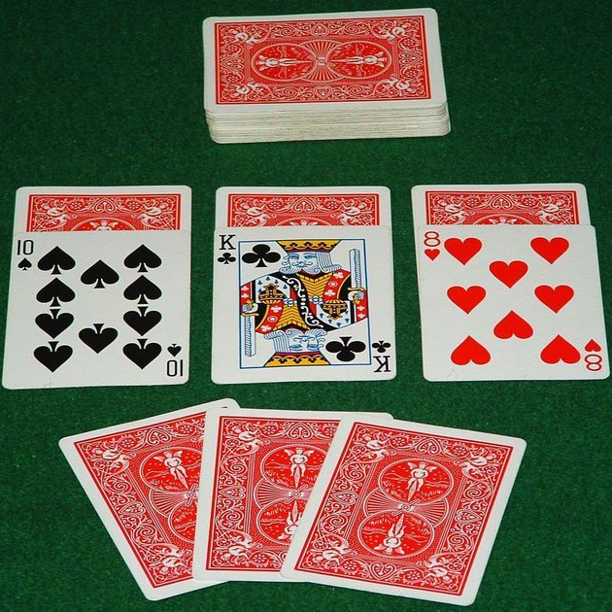
Rule set
Each player has: three blind cards (face-down cards), three face-up cards and three hand cards.
Before the game starts, players are allowed to swap their hand cards with face-down cards.
Each player has to play a card equal or higher to the previous card (in numerical value i.e ace is the highest).
A player has to have three cards in their hand until the deck runs out – thereafter the player moves onto their face-up cards and then the blind cards.
There are also special cards (wildcards). A two resets the play. A three is like an invisible card – it mirrors whatever was previously played. A ten discards the cards played thus far – those cards will be out of the game. A seven forces the next player to play under a seven or a wildcard.
The seven and ten can only be played when they can beat the card lower than them while a two and three can be played on anything.
If a player cannot play the appropriate card, they pick up the pile of played cards – obviously putting them at a disadvantage. As players finish all their cards, they drop out of the game (provided their last blind card beats the previous card).

